Slide 1
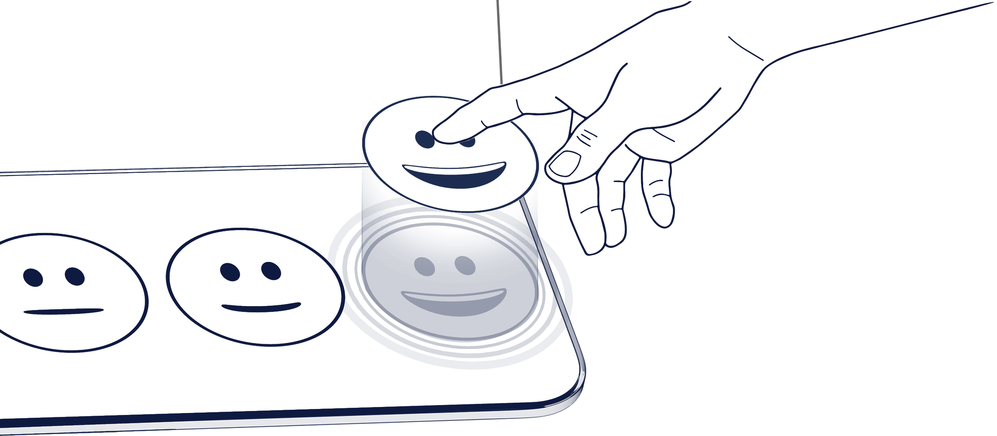
Touch-free Feedback
Tell us more:
QR Area
0.5” | 1cm
How do you rate our service today?

Slide 2
Touch-free Feedback
Tell us more:
QR Area
0.5” | 1 cm
How do you rate our service today?

